Slide 1


An Energy-Efficient and Massively Parallel Approach to Valid Numerics
John L. Gustafson, Ph.D.
CTO, Ceranovo
Director, Massively Parallel Technologies, Etaphase,
Clustered Systems

Slide 2
Big problems facing computing
More hardware parallelism than we know how to use
Too much energy and power needed per calculation
Not enough bandwidth (the “memory wall”)
Rounding errors more treacherous than people realize
Rounding errors prevent use of parallel methods
Sampling errors turn physics simulations into guesswork
Numerical methods are hard to use, require experts
IEEE floats give different answers on different platforms

Slide 3
The ones vendors care most about
More hardware parallelism than we know how to use
Too much energy and power needed per calculation
Not enough bandwidth (the “memory wall”)
Rounding errors more treacherous than people realize
Rounding errors prevent use of parallel methods
Sampling errors turn physics simulations into guesswork
Numerical methods are hard to use, require experts
IEEE floats give different answers on different platforms

Slide 4
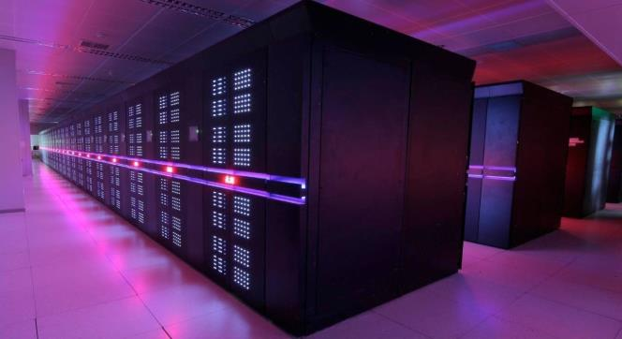
More parallel hardware than we can use
Huge clusters usually partitioned into 10s, 100s of cores
Few algorithms exploit millions of cores except LINPACK
Capacity is not a substitute for capability!

Slide 5
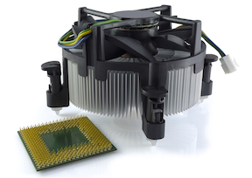
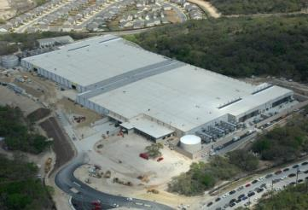
Too much power and heat needed
Huge heat sinks
20 MW limit for exascale
Data center electric bills
Mobile device battery life
Heat intensity means bulk
Bulk increases latency
Latency limits speed
Notes:
Whether it’s the battery life of a cell phone or a data center pushing the limits of how many megawatts it can draw from the local substation, power is now the biggest limit computer designers face. So what exactly in the computer is burning up most of the power?

Slide 6
Not enough bandwidth (“Memory wall”)
Operation | Energy consumed | Time needed
64-bit multiply-add | 200 pJ | 1 nsec
Read 64 bits from cache | 800 pJ | 3 nsec
Move 64 bits across chip | 2000 pJ | 5 nsec
Execute an instruction | 7500 pJ | 1 nsec
Read 64 bits from DRAM | 12000 pJ | 70 nsec
Notice that 12000 pJ @ 3 GHz = 36 watts!
One-size-fits-all overkill 64-bit precision wastes energy, storage bandwidth
Notes:
The surprise is, not the transistors! It’s the WIRES. Communication is now almost all of the parts cost, almost all of the time spent, and almost all of the energy and power consumed! If you swapped very transistor in a current computer for some new magical kind of switching device, like a carbon nanotube transistor, and if it used zero energy and went infinitely fast and didn’t cost anything, you would only improve the computer by a few percent. So the place I started looking for savings was this: For all the bits we move back and forth, how many of them are really necessary? Which brings up…

Slide 7
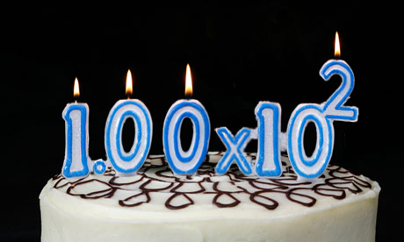
Happy 100th Birthday, Floating Point
1914: Torres proposes automatic computing with a fraction and a scaling factor.
2014: We still use a format designed for World War I hardware capabilities!
Notes:
Having the computer keep track of the scale factor, and being able to express very large and very small numbers, certainly was a huge step forward from only being able to compute with counting numbers. It takes major programming effort to compute with “fixed point” or integer arithmetic, because arithmetic is always overflowing or underflowing. By the way, the computer in the picture is the source of a popular myth that Thomas J. Watson said “I think there is perhaps a market for five computers in the world”. What he actually said to a stockholders meeting was that they did a sales tour for the IBM 701 to twenty customers, expecting perhaps five of them to order one, and actually got orders for eighteen.

Slide 8
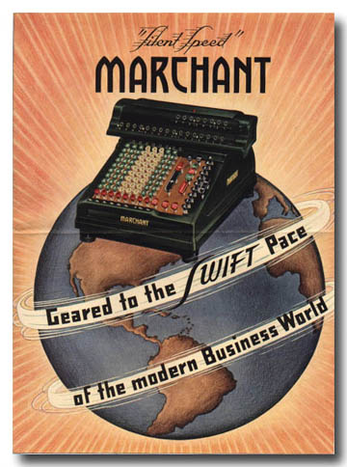
Floats designed for visible scratch work
OK for manual calculations
  Operator sees, remembers errors
  Can head off overflow, underflow
Automatic math hides all that
No one sees processor “flags”
Disobeys algebraic laws
Wastes bit patterns as NaNs
IEEE 754 “standard” is really the IEEE 754 guideline; optional rules spoil standard results
Notes:
Have you ever seen those old mechanical desk calculators? The computed about one digit of the answer every second, clanking away. A room full of those desk calculators were operated by people, usually women, called “computers”. A room full of computers, the people kind, did all the calculations used for the design of the first atomic bomb in 1945. Funny to think that the US government worries about us shipping powerful computers to other countries because they might allow them to design a nuclear weapon! Anyway, as soon as computers like the IBM 701 became widespread, it was the numerical equivalent of handing a gun to a five-year-old. Programmers gleefully attempted to use textbook algebra to solve problems, and when the answers came out so inaccurate as to be useless, it could take weeks to figure where in the automatic calculation things went wrong.

Slide 9
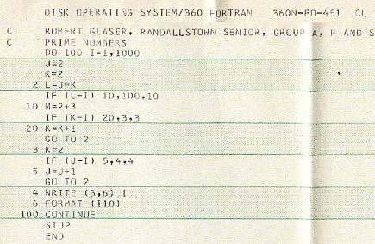
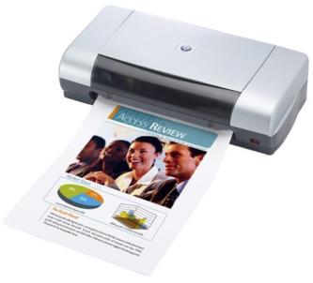
Analogy: Printing in 1970 vs. 2014
1970: 30 sec per page
2013: 30 sec per page
Faster technology is for better prints,
not thousands of low-quality prints per second.
Why not do the same thing with computer arithmetic?

Slide 10
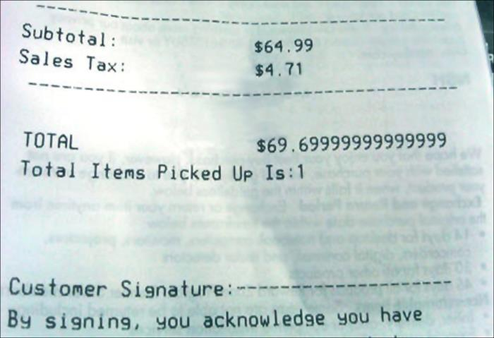
This is just… sad.

Slide 11
Floats prevent use of parallelism
No associative property for floats
(a + b) + (c + d) (parallel) ≠ ((a + b) + c) + d (serial)
Looks like a “wrong answer”
Programmers trust serial, reject parallel
IEEE floats report rounding, overflow, underflow in processor register bits that no one ever sees.

Slide 12
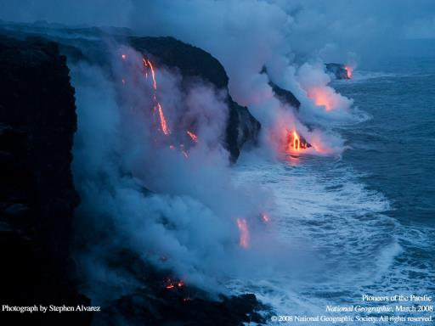
A New Number Format: The Unum
Universal numbers
Superset of IEEE types, both 754 and 1788
Integers➔floats➔unums
No rounding, no overflow to ∞, no underflow to zero
They obey algebraic laws!
Safe to parallelize
Fewer bits than floats
But… they’re new
Some people don’t like new
“You can’t boil the ocean.”
—Former Intel exec, when shown the unum idea

Slide 13
Three ways to express a big number
Avogadro’s number: ~6.022×10²³ atoms or molecules
Sign-Magnitude Integer (80 bits):
0 1111111100001010101001111010001010111111010100001001010011000000000000000000000
sign
Lots of digits
IEEE Standard Float (64 bits):
0 10001001101 1111111000010101010011110100010101111110101000010011
sign
exponent (scale)
fraction
Unum (29 bits):
utag
Self-descriptive “utag” bits track and manage uncertainty, exponent size, and fraction size
0 11001101 111111100001 1 111 1011
sign
exp.
frac.
ubit
exp. size
frac. size

Slide 14
Why unums use fewer bits than floats
Exponent smaller by about 5 – 10 bits, typically
Trailing zeros in fraction compressed away, saves ~2 bits
Shorter strings for more common values
Cancellation removes bits and the need to store them
IEEE Standard Float (64 bits):
0 10001001101 1111111000010101010011110100010101111110101000010011
Unum (29 bits):
0 11001101 111111100001 1 111 1011

Slide 15
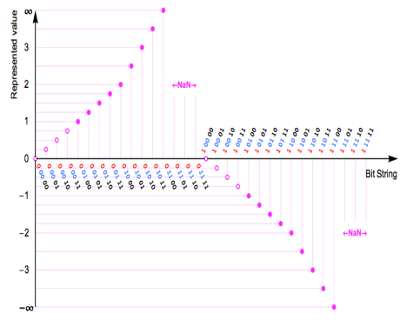
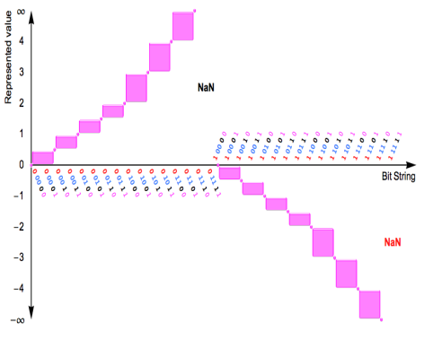
Open ranges, as well as exact points
Bit string meanings
using IEEE Float rules
Bit string meanings
in unum format
Complete representation of all real numbers using a finite number of bits

Slide 16
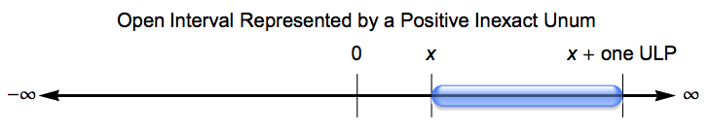
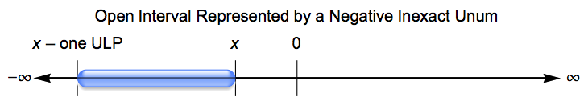
Ubounds are the hull of 1 or 2 unums
Includes closed, open, half-open intervals
Includes ±∞, empty set, quiet and signalling NaN
Unlike traditional intervals, ubounds are closed and lossless under set operations

Slide 17
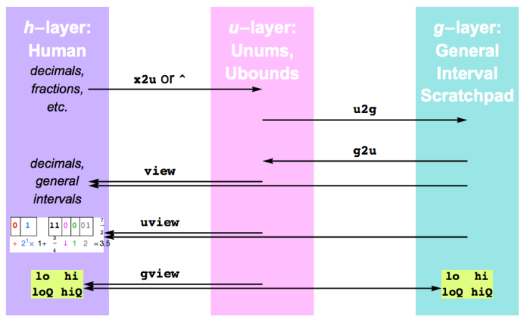
The three layers of computing
Grammar rules for exact, inexact
High-efficiency floats and real intervals
Limited set of fused operations

Slide 18

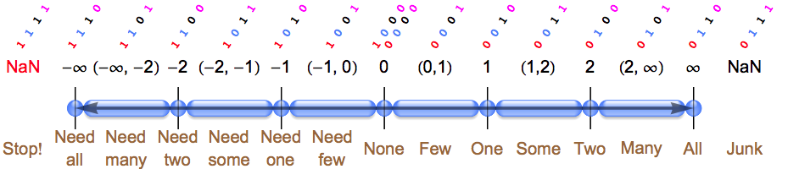
The Warlpiri unums
Before the aboriginal Warlpiri of Northern Australia had contact with other civilizations, their counting system was “One, two, many.”
Maybe they were onto something.

Slide 19
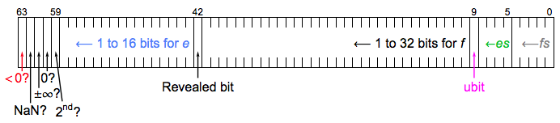
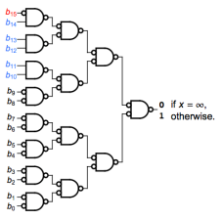
Fixed-size unums: faster than floats
Warlpiri ubounds are one byte, but closed system for reals
Unpacked unums pre-decode exception bits, hidden bit
Circuit required for
“IEEE half-precision float = ∞?”
Circuit required for
“unum = ∞?”
(any precision)

Slide 20
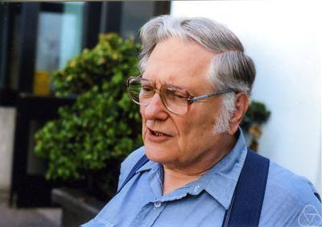
Floating Point II: The Wrath of Kahan
Berkeley professor William Kahan is the father of modern IEEE Standard floats
Also the authority on their many dangers
Every idea to fix floats faces his tests that expose how new idea is even worse
Working unum environment completed August 13, 2013.
Can unums survive the wrath of Kahan?

Slide 21
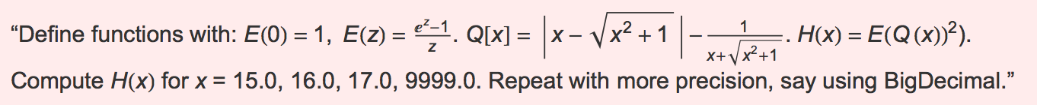
A Typical Kahan Challenge
Correct answer: (1, 1, 1, 1).
IEEE 32-bit: (0, 0, 0, 0) FAIL
IEEE 64-bit: (0, 0, 0, 0) FAIL
Myth: “Getting the same answer with increased precision means the answer is correct.”
IEEE 128-bit: (0, 0, 0, 0) FAIL
Extended precision math packages: (0, 0, 0, 0) FAIL
Interval arithmetic: Um, somewhere between –∞ and ∞. EPIC FAIL
Unums, 6-bit average size: (1, 1, 1, 1) CORRECT
I have been unable to find a problem that “breaks” unum math.

Slide 22
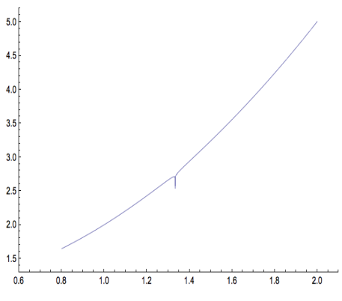
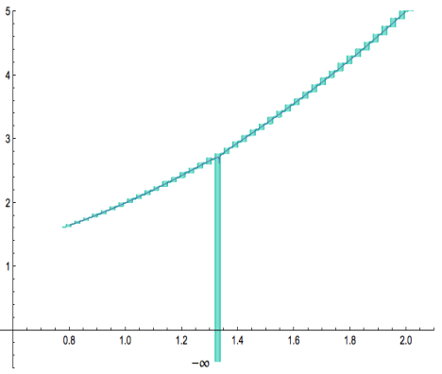
Kahan’s “Smooth Surprise”
Find minimum of log(|3(1–x)+1|)/80 + x² + 1 in 0.8 ≤ x ≤ 2.0
Plot, test using half a million
double-precision IEEE floats.
Shows minimum at x = 0.8.
FAIL
Plot, test using a few dozen
very low-precision unums.
Shows minimum where
x spans 4/3.
CORRECT

Slide 23
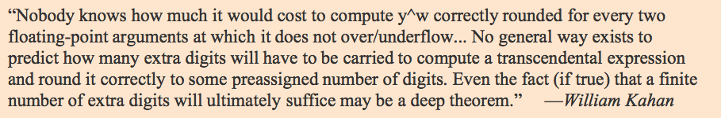
Kahan on the computation of powers
I sent Kahan my fixed-cost, fixed-storage method, and he said it looked “impractical.”
I asked if he had a method that shows the following computation is exact:
Have not heard from him since.
5.9604644775390625^{0.875} = 4.76837158203125

Slide 24
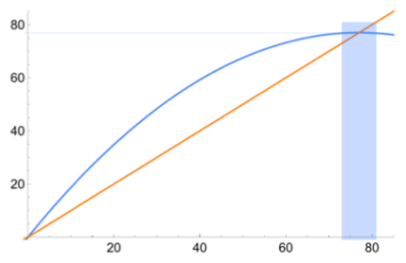
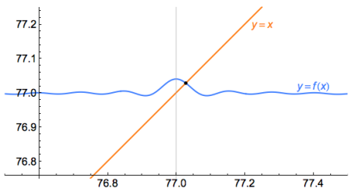
Two can play this game, Professor K.
Stable fixed point found by floats, not by traditional intervals
Unums find both stable point, and unstable point at origin
Finding exact stable point is mathematically incorrect!
Adding a tiny wobble sin(x)/x destroys floats, but not unums.
Unums can do anything floats can do, through explicit use of the guess function.

Slide 25
Rump’s Royal Pain
Compute 333.75y⁶ + x²(11x²y² – y⁶ – 121y⁴ – 2) + 5.5y⁸ + x/(2y)
where x = 77617, y = 33096.
Using IBM (pre-IEEE Standard) floats, Rump got
  1.172603 in 32-bit precision
  1.1726039400531 in 64-bit precision
  1.172603940053178 in 128-bit precision
Using IEEE double precision: 1.18059x10²¹
Correct answer: –0.82739605994682136…!
Didn’t even get sign right
With unums: Correct answer to 23 decimals using an average of
only 75 bits per number. Not even IEEE 128-bit precision can do that.

Slide 26
Some fundamental principles
Bound the answer as tightly as possible within the numerical environment, or admit defeat.
No more guessing
No more “the error is O(h^{n})” type estimates
The smaller the bound, the greater the information
Performance is information per second
Maximize information per bit
Fused operations are always explicitly distinct from their non-fused versions and results are identical across platforms

Slide 27
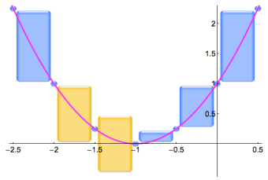
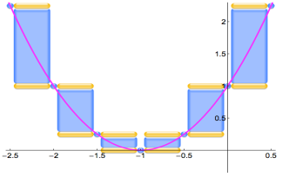
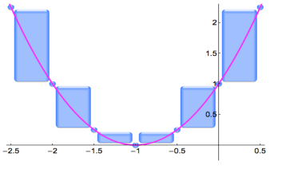
Polynomials: bane of classic intervals
Dependency and closed endpoints lose information (amber)
Unum polynomial evaluator loses no information.

Slide 28
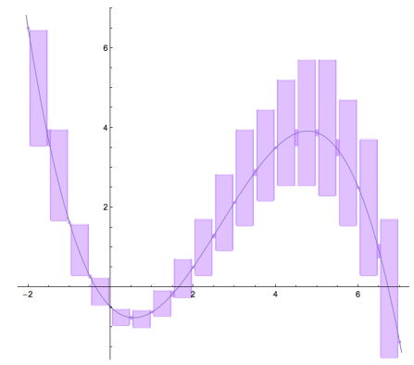
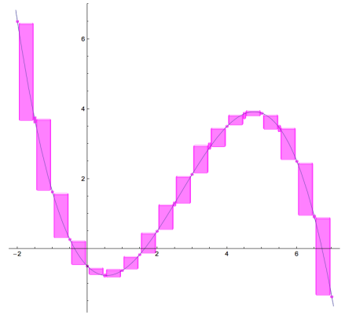
Polynomial evaluation solved at last
Mathematicians have sought this for at least 60 years.
“Dependency Problem” creates sloppy
range when input is an interval
Unum evaluation refines answer to
limits of the environment precision

Slide 29
Uboxes and solution sets
A ubox is a multidimensional unum
Exact or ULP-wide in each dimension
Sets of uboxes constitute a solution set
One dimension per degree of freedom in solution
Solves the main problem with interval arithmetic
Super-economical for bit storage
Data parallel in general

Slide 30

Calculus considered harmful
Computers are discrete
Calculus is continuous
Ensures sampling errors
Changes problem to fit the tool

Slide 31
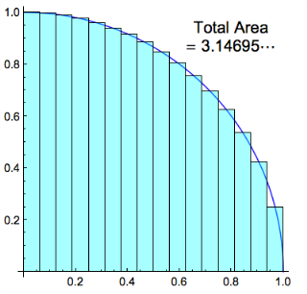
Deeply Unsatisfying Error Bounds
4x
Classical numerical texts
teach this “error bound”:
What is f ′′? Where is ξ?
What is the bound??
Bound is often infinite, which means no bound at all
“Whatever it is, it’s four times better if we make h half as big” creates demand for supercomputing that cannot be satisfied.
Error ≤ (b – a) h² |f ′′(ξ)| / 24

Slide 32
Two “ubox methods”, both mindless
Paint bucket: find one solution point, test neighbors and classify as solution or fail until no more neighbors to test
  Works if solution is known to be a connected set
  Requires a starting point “seed”
  Wave front of trial uboxes can be computed in parallel
Try the universe: Use Warlpiri uboxes (4-bit precision) to tile all of n-space; increment exponent and fraction size automatically
  13^{n} things to do in parallel (!)
  Finds every solution, no matter what, since all of n-space is represented
  Detects ill-posed problems and solves them anyway
  Parallelism adjusts from 3 to trillions

Slide 33

Quarter-circle example
Suppose all we know is x² + y² = 1, and x and y are ≥ 0
Suppose we have at most 2 bits exponent, 4 bits fraction
Task:
Bound the quarter circle area.
Bound the value of π.

Slide 34
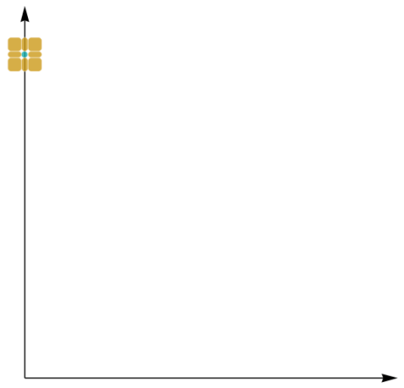
Set is connected; need a seed
We know x = 0, y = 1 works
Find its eight ubox neighbors in the plane
Test x² + y² = 1, x ≥ 0, y ≥ 0
Solution set is green
Trial set is amber
Failure set is red
Stop when no more trials

Slide 35
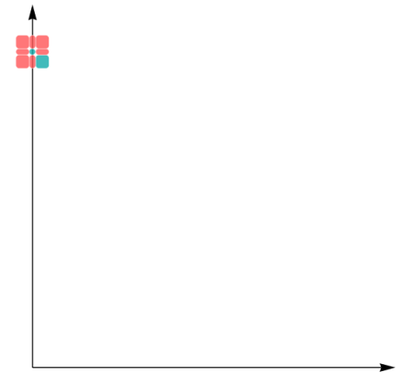
Exactly one neighbor passes
Unum math automatically excludes cases that floats would accept
Trials are neighbors of new solutions that
  Are not already failures
  Are not already solutions
Note: no calculation of
Not part of the unit circle

Slide 36
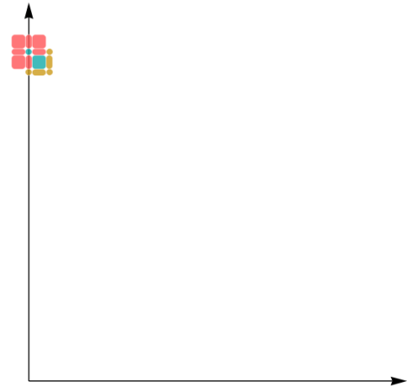
The new trial set
Five trial uboxes to test
Perfect, easy parallelism for multicore
Each ubox takes only 15 to 23 bits
Ultra-fast operations
Skip to the final result…

Slide 37
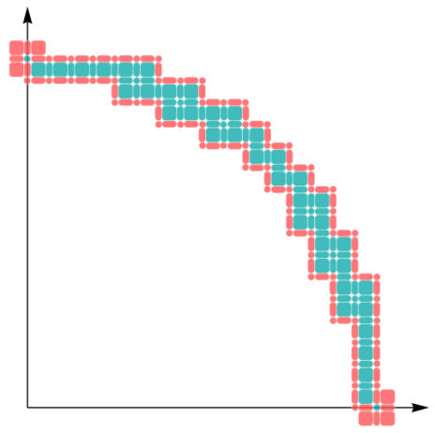
The complete quarter circle
The complete solution, to this finite precision level
Information is reciprocal of green area
Use to find area under arc,
bounded above and below
Proves value of π to an accuracy of 3%
No calculus needed, or divides, or square roots

Slide 38
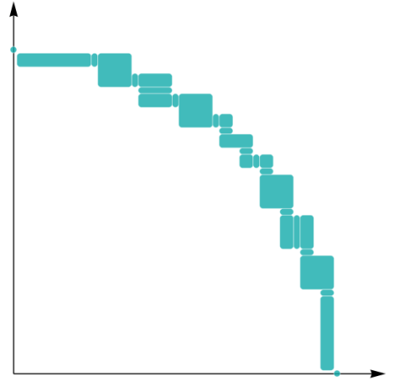
Compressed Final Result
Coalesce uboxes to largest possible ULP values
Lossless compression
Total data set: 603 bits!
6x faster graphics than current methods
Instead of ULPs being the source of error, they are the atomic units of computation

Slide 39
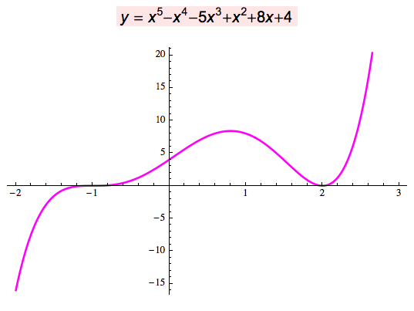
Fifth-degree polynomial roots
Analytic solution: There isn’t one.
Numerical solution: Huge errors from rounding
Unums: quickly return
x = –1, x = 2 as the exact
solutions. No rounding.
No underflow. Just…
the correct answer.
With as few as 4 bits
for the operands!

Slide 40
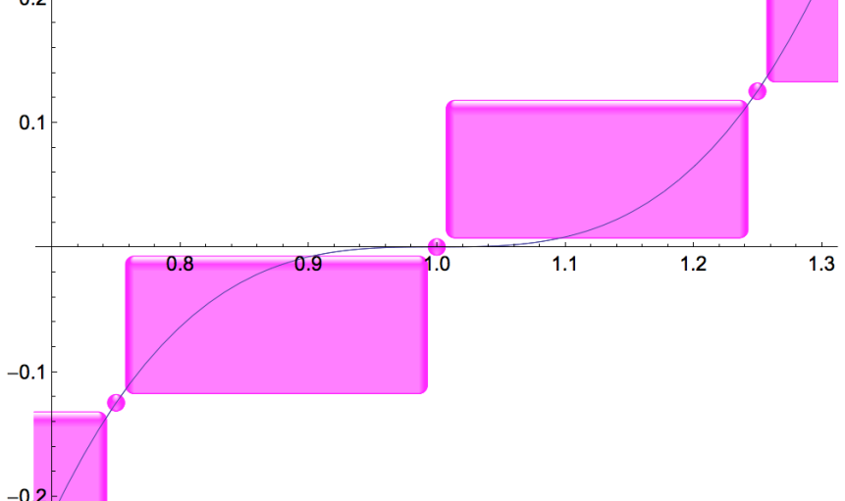
The power of open-closed endpoints
Root-finding just works.

Slide 41

Classical Numerical Analysis
Time steps
  Use position to estimate force
  Use force to estimate acceleration
  Update the velocity
  Update the position
  Lather, rinse, repeat
Accumulates rounding
and sampling error, both unknown
Cannot be done in parallel
start
Δt
Δt
Δt
Δt
Actual behavior
M

Slide 42
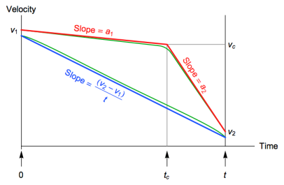
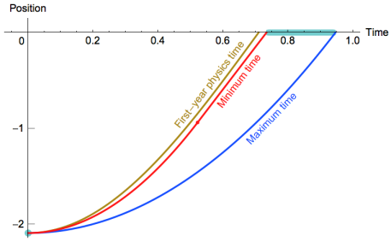
A New Type of Parallelism
Space steps, not time steps
Acceleration, velocity bounded
in any given space interval
Find traversal time as a function
of space step (2D ubox)
Massively parallel!
No rounding error
No sampling error
Obsoletes existing
ODE methods

Slide 43

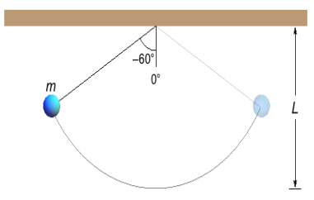
Pendulums Done Right
Physics teaches us it’s a harmonic oscillator with period
Force-fits nonlinear ODE
into linear ODE for which calculus works.
WRONG answer

Slide 44
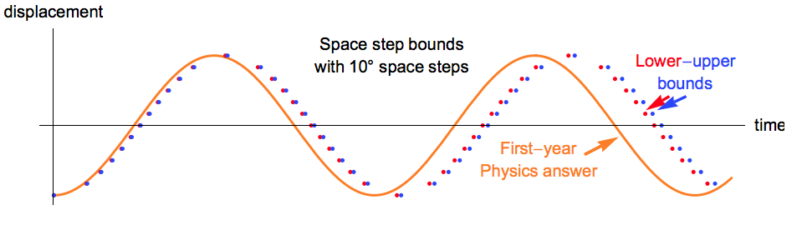
Physical Truth vs. Force-Fit Solution
Bends the problem to fit solution methods

Slide 45
Uboxes for linear solvers
  If the A and b values in Ax=b are rounded, the “lines” have width from uncertainty
  Apply a standard solver, and get the red dot as “the answer”, x. A pair of floating-point numbers.
  Check it by computing Ax and see if it rigorously contains b. Yes, it does.
  Hmm… are there any other points that also work?

Slide 46
Float, Interval, and Ubox Solutions
  Point solution (black dot) just gives one of many solutions; disguises answer instability
  Interval method (gray box) yields a bound too loose to be useful
  The ubox set (green) is the best you can do for a given precision
  Uboxes reveal ill-posed nature… yet provide solution anyway
  Works equally well on nonlinear problems!

Slide 47

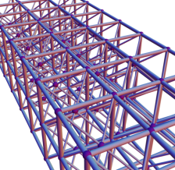
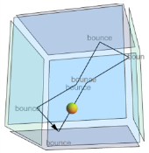
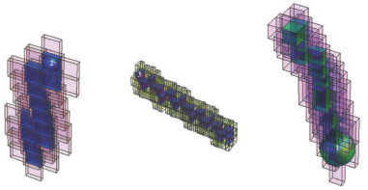
Other Apps with Ubox Solutions
Photorealistic computer graphics
N-body problems
Structural analysis
Laplace’s equation
Perfect gas models without statistical mechanics
Imagine having provable bounds on answers for the first time, yet with easier programming, less storage, less bandwidth use, less energy/power demands, and abundant parallelism.

Slide 48
Breakthroughs enabled by unums
Bit-identical results across systems, unlike IEEE floats
First error-free polynomial evaluator
Solution to “The Table-Makers Dilemma”
First deterministic evaluation of x^{y}
First massively parallel, bounded ODE solver
Universal solver for f(x) = 0 when f is continuous
Provably bounded physics simulations – real science!
P = NP for finding maxima, minima, roots perfectly

Slide 49
Revisiting the Big Challenges-1
More hardware parallelism than we know how to use
  Uboxes reveal vast new sources of data parallelism, the easiest kind
Too much energy and power needed per calculation
  Unum arithmetic cuts the main energy hog by about 50%
Not enough bandwidth (the “memory wall”)
  More use of CPU transistors, fewer bits moved to/from memory
Rounding errors more treacherous than people realize
  Unum metadata eliminates rounding error, automates precision choice
Rounding errors prevent use of multicore methods
  Unums restore algebraic laws, eliminating the parallelization deterrent

Slide 50
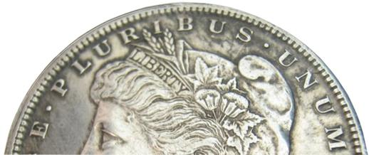
Revisiting the Big Challenges-2
Sampling errors turn physics simulations into guesswork
  Uboxes produce provable bounds on physical behavior
Numerical methods are hard to
use, require expertise
  “Paint bucket” and “Try the universe”
  are brute force general methods that
  need no expertise
  …not even calculus

Slide 51
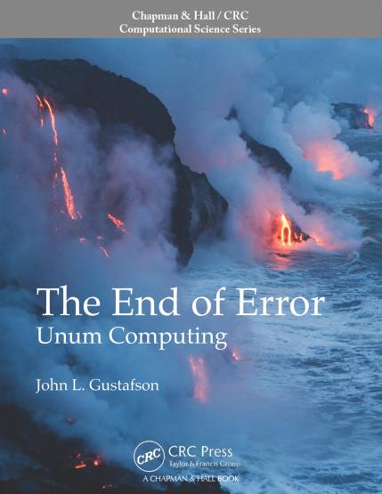
The End of Error
A complete text on unums and uboxes is being copy-edited right now. CRC Press will publish very soon.
Aimed at general reader; mathematicians will hate its casual style
Complete prototype environment made available as Mathematica notebook through publisher

